Slide 1
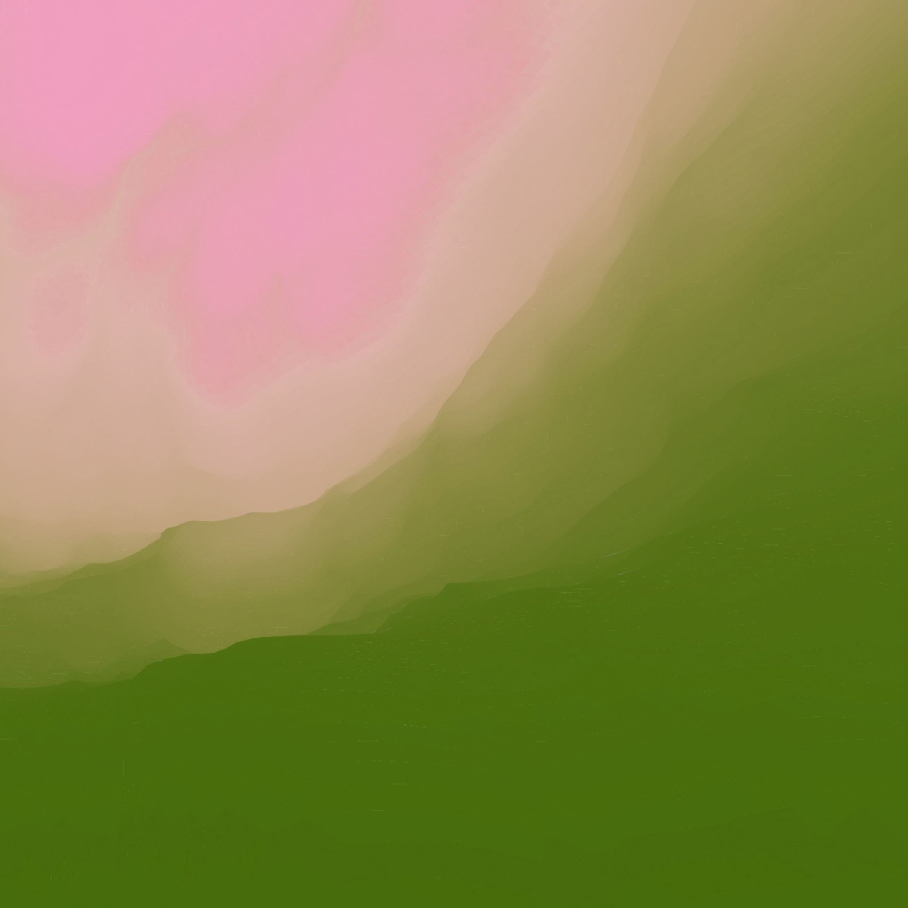
Satellite Imagery Land Use classification Project
Presented by Abdullah [abd15]

Slide 2
Table of contents
Objective of the project
Scope of the project
Data Used and how it was collected
Technologies used
Use Cases of the Project

Slide 3

Objective of the project
Is to create an application that uses machine learning models to determine land use of an area from the satellite imagery of that area

Slide 4
Scope of the project
Stage 1
Data Acquisition and Preprocessing
Stage 2
Model Development
Stage 3
Testing
Stage 4
Stage 5
Change Detection
GUI
Collecting Data From Copernicus Browser from the Sentinel 2a Satellite
Implement the models in the Application
Experiment on which models are better
Train the Models
Implement the Algorithm which then compares multiple images together and highlights change over time
Implement a simple GUI for the Application using the Qtpy python library
Implement python unit tests and test edge cases of the application

Slide 5
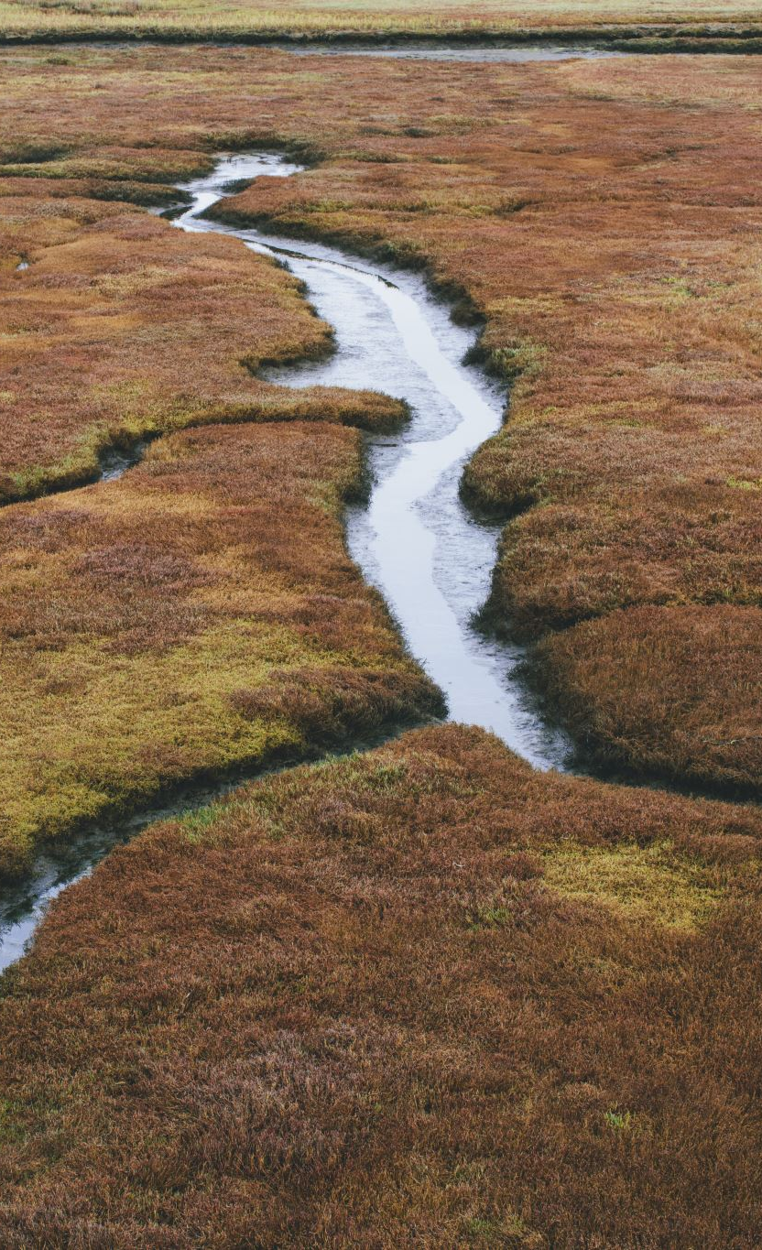
Use Cases of the project
Urban Planning and Expansion Monitoring: Aid in the assessment of urban sprawl and infrastructure development, supporting city planning and environmental impact assessments
Agricultural Land Use Analysis: Monitor crop types, farming practices, and seasonal changes to improve agricultural productivity and sustainability
Forest and Natural Resource Management: Track deforestation, forest health, and land degradation to support conservation efforts and natural resource management
Water Resources Management: Assess water bodies for changes in size and quality, aiding in water conservation and management strategies
Climate Change Impact Assessment: Analyze changes in land use and vegetation cover as indicators of climate change effects
Disaster Response and Recovery: Evaluate the impact of natural disasters on land use, supporting effective response and recovery efforts

Slide 6
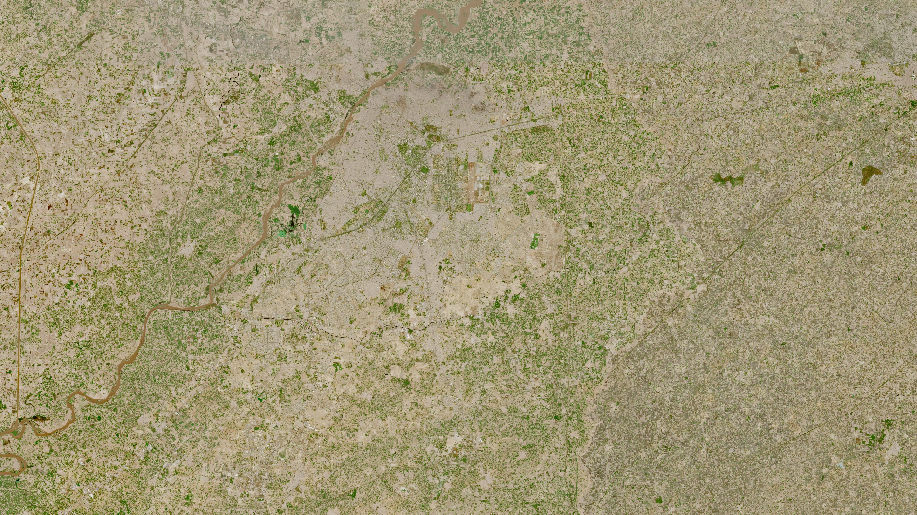

Slide 7
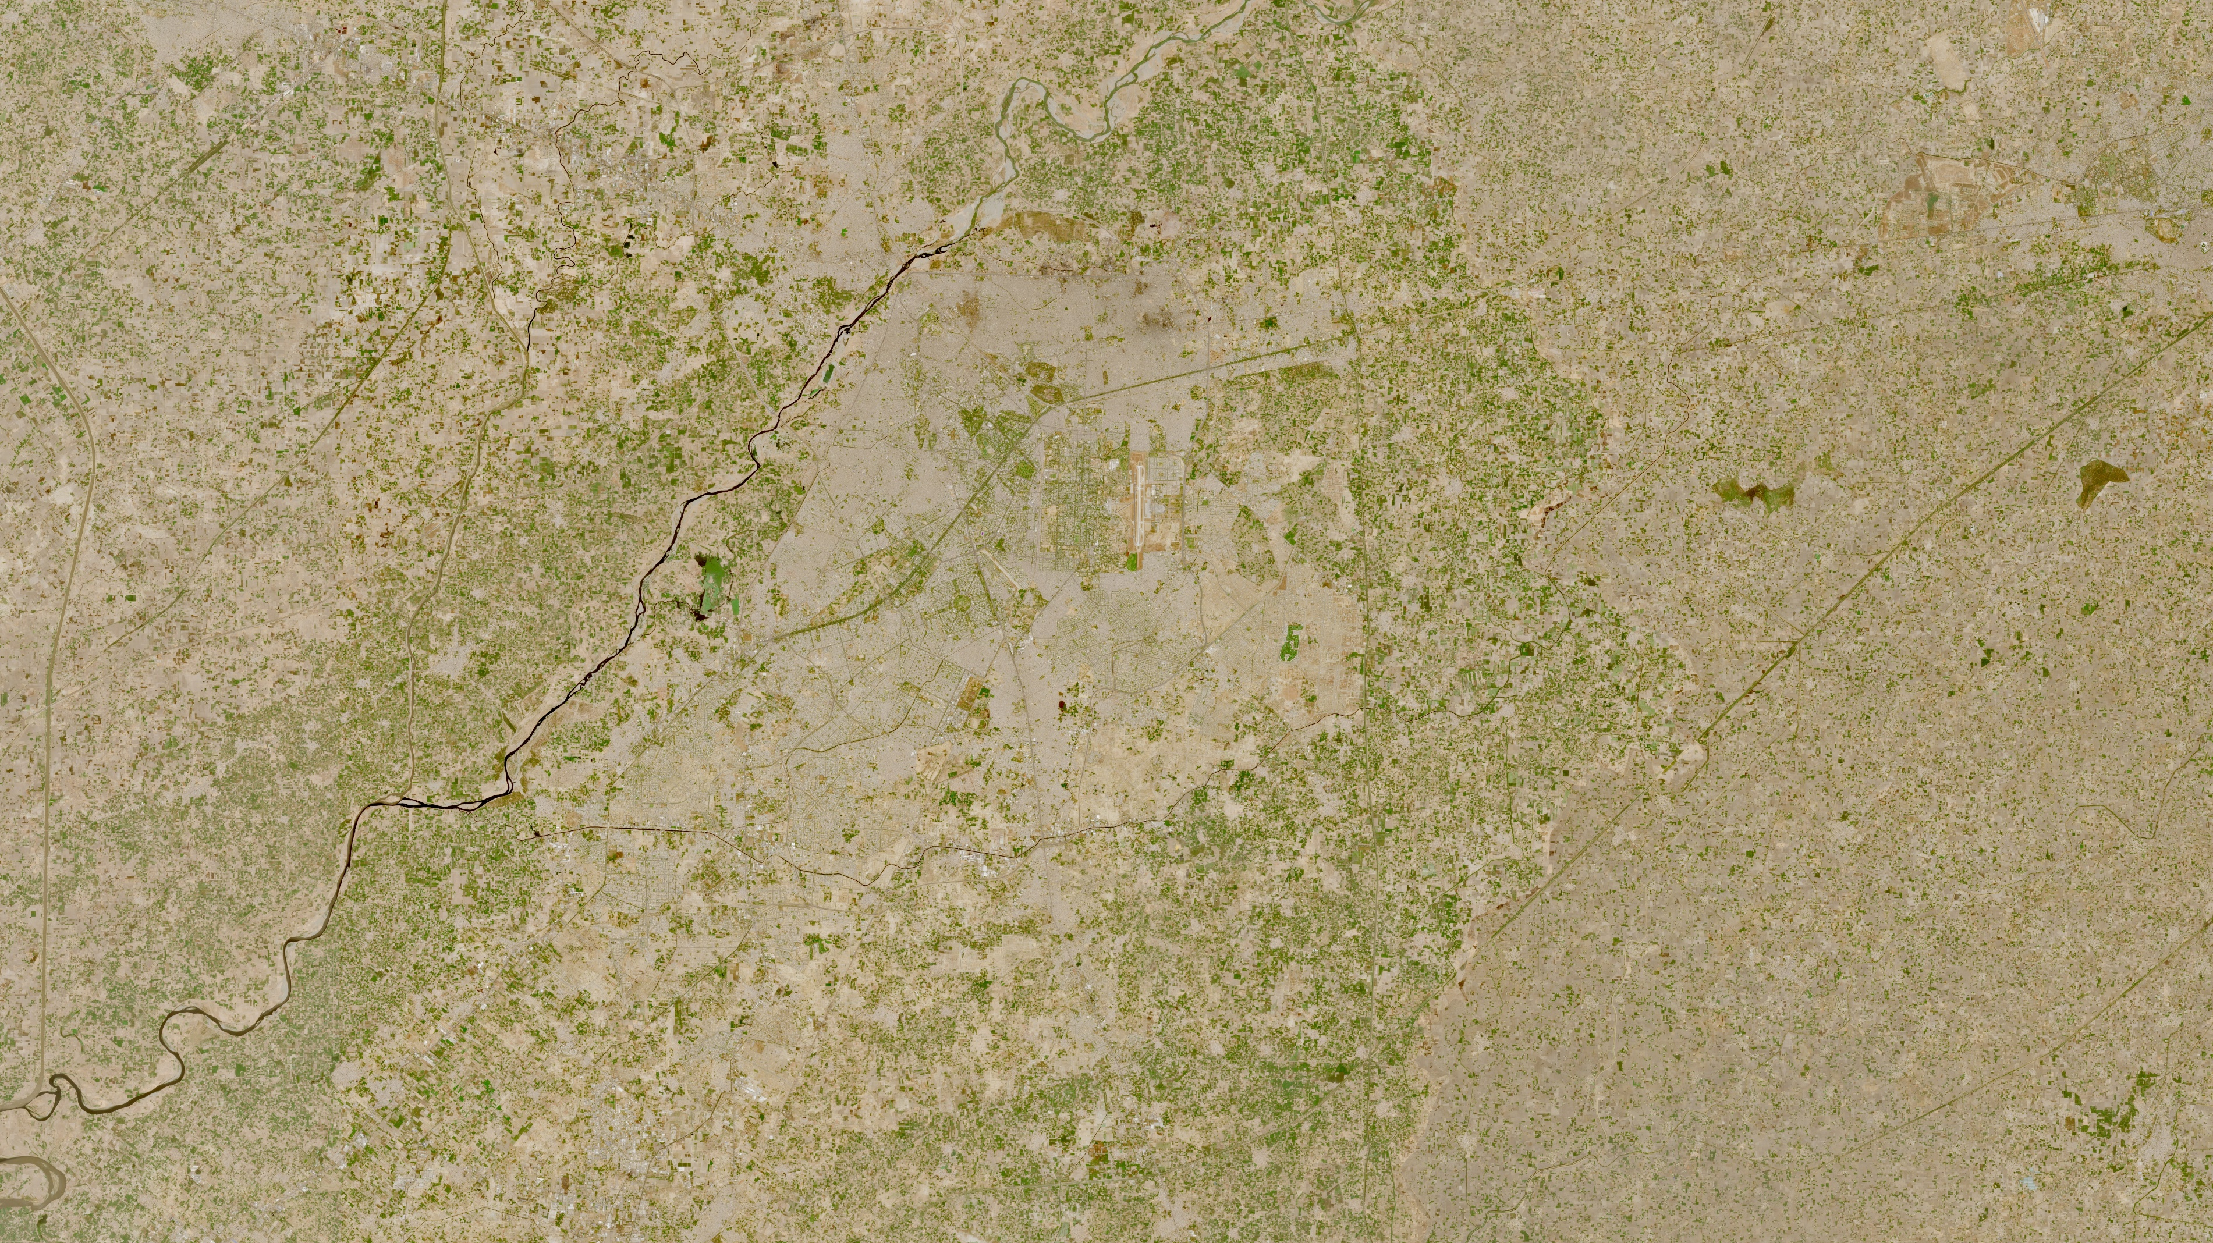

Slide 8
Technologies used
Python 3.11
OpenCv
TensorFlow
QTPY
ScikitLearn

Slide 9
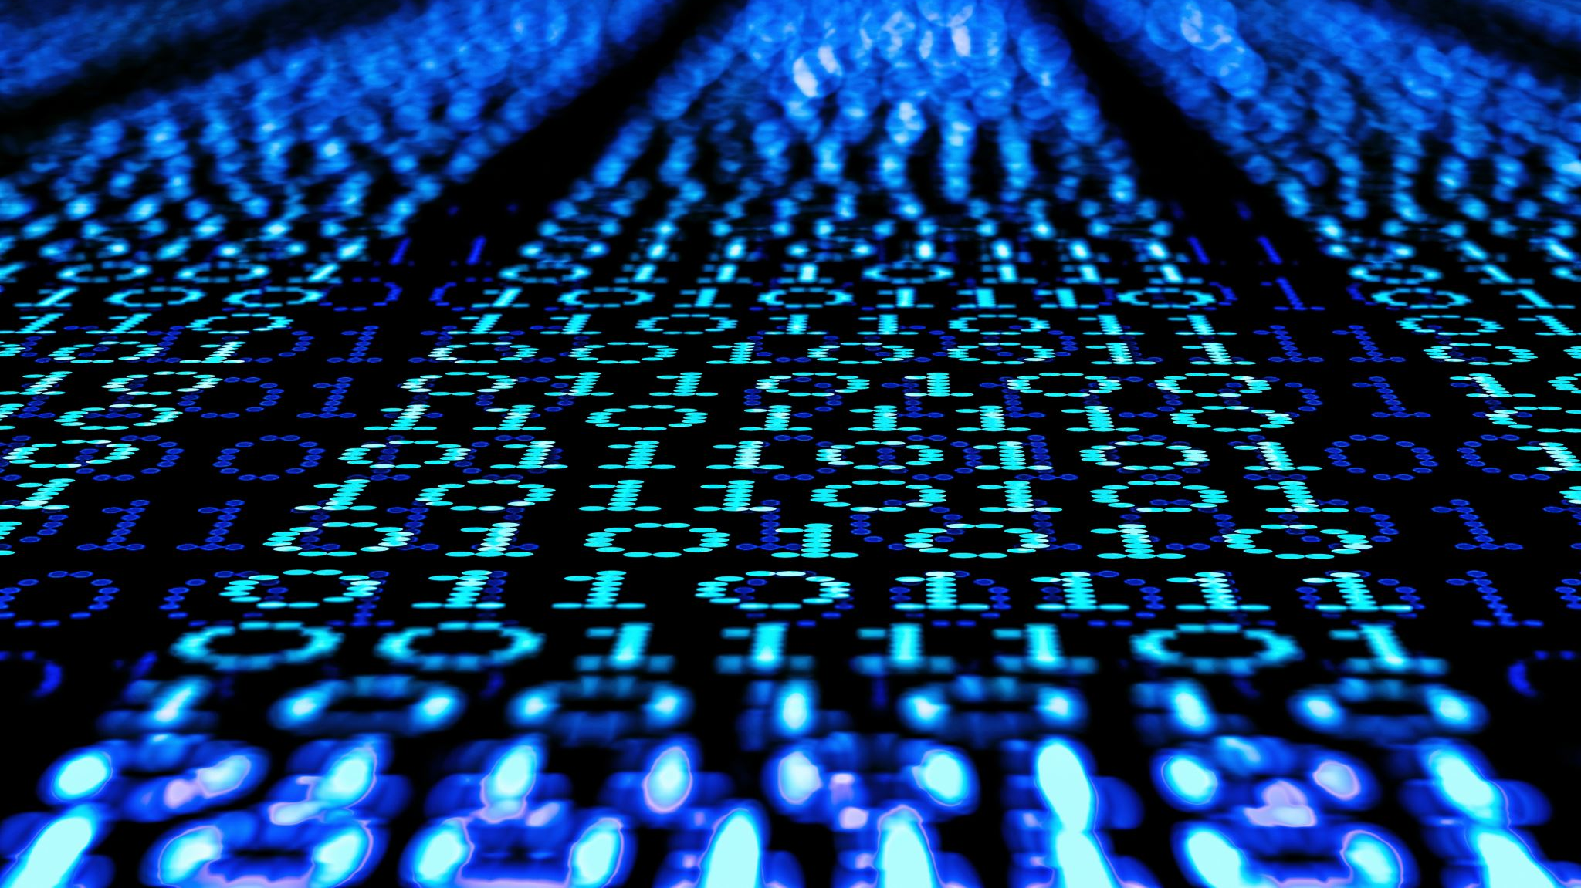
Now to the CODE

